Slide 1
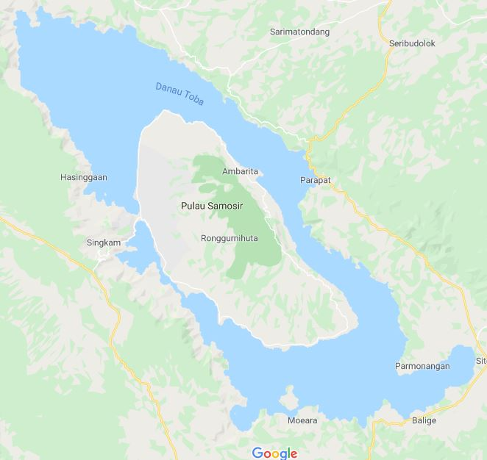
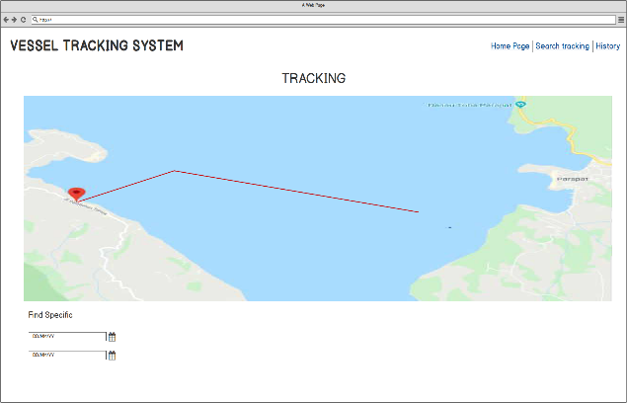
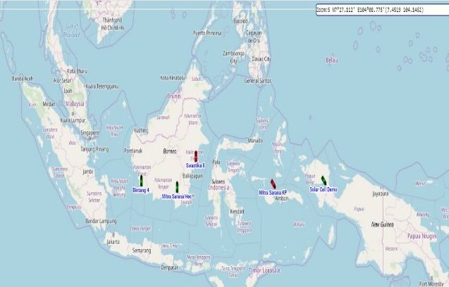
Logo Lembaga
TITLE OF PRESENTATION
Author
Supervisor :
PRESENTATION

Slide 2
Overview
Review
Step of Experiment
Conclusion
Analysis
Demo

Slide 3
Review
System Planning

Slide 4

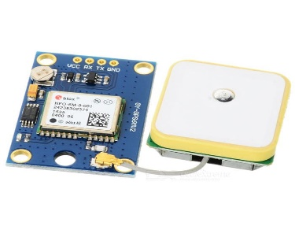
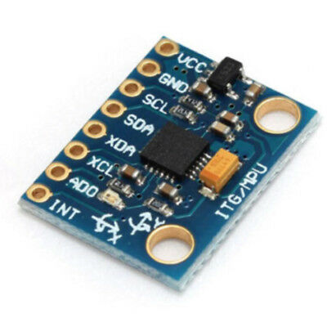
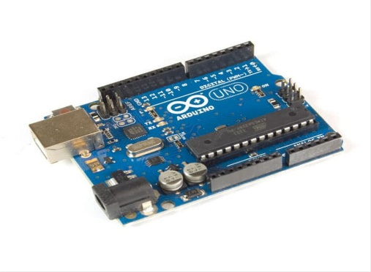

System Planning
Location
&
GPS & MPU 6050
Arduiono

Slide 5
Step of Experiment
Product Implementation
Testing The Product Components

Slide 6
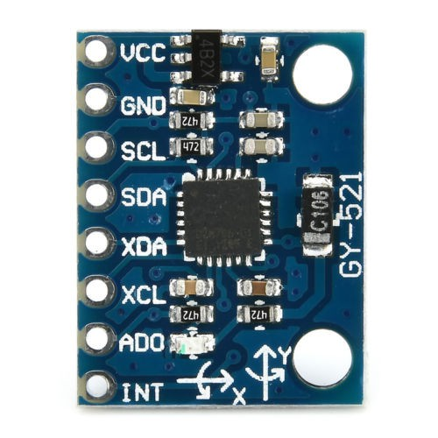
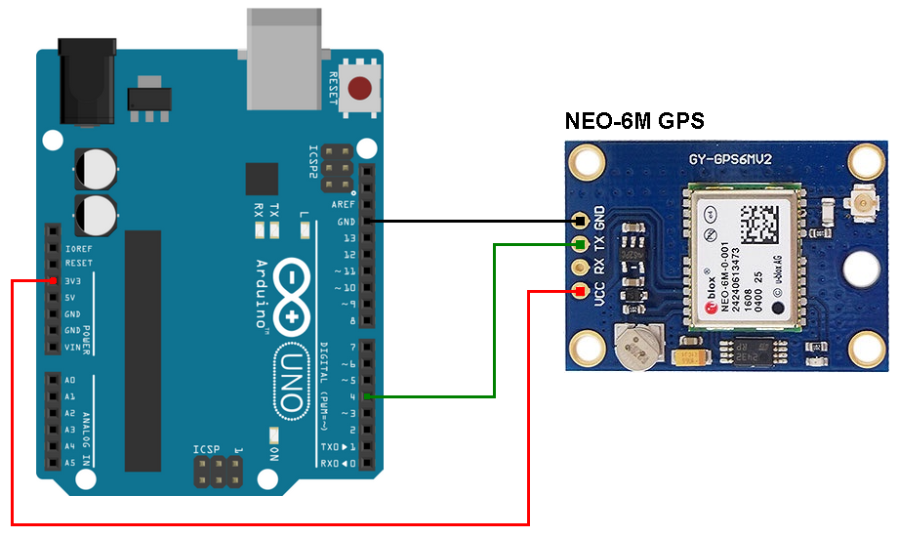
Product Implementation

Slide 7
Testing the product Component
MPU 6050
GPS Ublox 6M
Kalman Filter

Slide 8
MPU 6050

Slide 9
MPU 6050
 | Time | Acc_X | Acc_Y | Acc_Z
1
2
3
4
5
6
7
8
9
10
11
12
13
14
15
16
17
18
19
20
Rata-rata

Slide 10
Kalman Filter

Slide 11
GPS & MPU 6050
Analysis

Slide 12
GPS Ublox 6M
& MPU 6050
Time | GPS |  | Accelerometer
 | Latitude | Longitude | AccX | AccY | AccZ
10.25.53 |  |  | -0,74 | -0,73 | 0,38
10.25.54 |  |  | -0,76 | -0,68 | 0,31
10.25.55 |  |  | -0,77 | -0,71 | 0,43
10.25.56 |  |  | -0,83 | -0,64 | 0,42
10.25.57 | 3,59103 | 98,73714
10.25.57 |  |  | -0,7 | -0,75 | 0,362
10.25.58 |  |  | -0,68 | -0,81 | 0,26
10.25.59 |  |  | -0,63 | -0,84 | 0,31
10.26.00 |  |  | -0,64 | -0,8 | 0,4
10.26.01 | 3,59102 | 98,73713
10.26.02 |  |  | -0,67 | -0,81 | 0,31
10.26.03 |  |  | -0,75 | -0,87 | 0,17
10.26.04 |  |  | -0,54 | -0,88 | 0,19
10.26.05 |  |  | -0,73 | -0,81 | 0,26
10.26.06 | 3,59106 | 98,73709
10.26.06 |  |  | -0,67 | -0,87 | 0,23
10.26.07 |  |  | -0,53 | -0,83 | 0,30
10.26.08 |  |  | -0,63 | -0,94 | 0,32
10.26.09 |  |  | -0,61 | -0,90 | 0,30
10.26.10 | 3,59110 | 98,73712
10.26.11 |  |  | -0,61 | -0,93 | 0,28
10.26.11 |  |  | -0,58 | -0,95 | 0,37
10.26.12 |  |  | -0,61 | -0,84 | 0,28
10.26.13 |  |  | -0,65 | -0,93 | 0,29
10.26.14 | 3,59112 | 98,73714

Slide 13
Simulation Video
Demo

Slide 14
Conclusion
Conclusion

Slide 15
Conclusion
Products that have been made can detect that the object being tested is in a stationary position and moves or moves places.
The use of the Kalman Filter method is able to provide better accuracy. The results of the study showed that the accuracy of the coordinates of an object increased by about 1.69 meters compared to coordinates without the Kalman Filter.
The experimental results of the merging of GPS and accelerometer are done through the Kalman Filter estimation technique which is the optimal way to improve sensory data.
Products made can monitor the position and acceleration of an object.

Slide 16
THANK YOU

